Slide 1
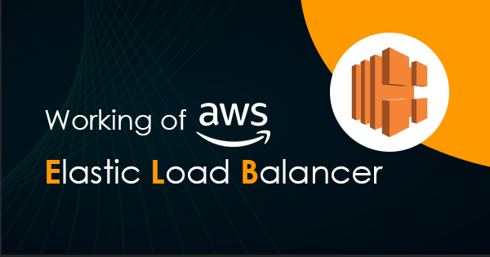

Slide 2

Topics
What is ELB
Type of ELB
X-Forwarded-For Header
Exam Tip

Slide 3

What is ELB?
Elastic Load Balancing automatically distributes incoming application traffic across multiple targets, such as Amazon EC2 instances, containers, IP addresses, Lambda functions, and virtual appliances.
It can handle the varying load of your application traffic in a single Availability Zone or across multiple Availability Zones.
Elastic Load Balancing offers four types of load balancers that all feature the high availability, automatic scaling, and robust security necessary to make your applications fault tolerant

Slide 4

Type of ELB
Application Load Balancer
Network Load Balancer
Classic Load Balancer

Slide 5

Application Load Balancer
Application Load Balancer operates at the request level (layer 7), routing traffic to targets (EC2 instances, containers, IP addresses, and Lambda functions) based on the content of the request.
Ideal for advanced load balancing of HTTP and HTTPS traffic, Application Load Balancer provides advanced request routing targeted at delivery of modern application architectures, including microservices and container-based applications.
Application Load Balancer simplifies and improves the security of your application, by ensuring that the latest SSL/TLS ciphers and protocols are always used
Example: Macbook-pro laptop, Tesla Model X (multi-application/feature)

Slide 6
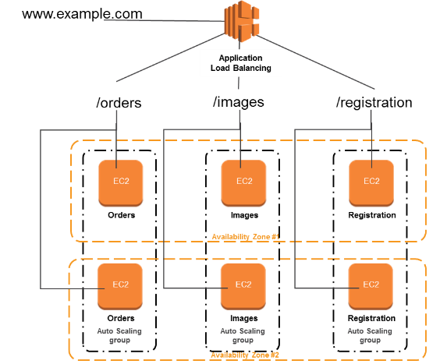
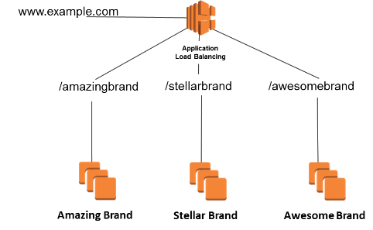
Application Load Balancer

Slide 7

Network Load Balancer
Network Load Balancer operates at the connection level (Layer 4), routing connections to targets (Amazon EC2 instances, microservices, and containers) within Amazon VPC, based on IP protocol data.
Ideal for load balancing of both TCP and UDP traffic, Network Load Balancer is capable of handling millions of requests per second while maintaining ultra-low latencies. Network Load Balancer is optimized to handle sudden and volatile traffic patterns while using a single static IP address per Availability Zone.
It is integrated with other popular AWS services such as Auto Scaling, Amazon EC2 Container Service (ECS), Amazon CloudFormation, and AWS Certificate Manager (ACM)
Extreme performance is required – example :- Gaming laptops, Sports car

Slide 8
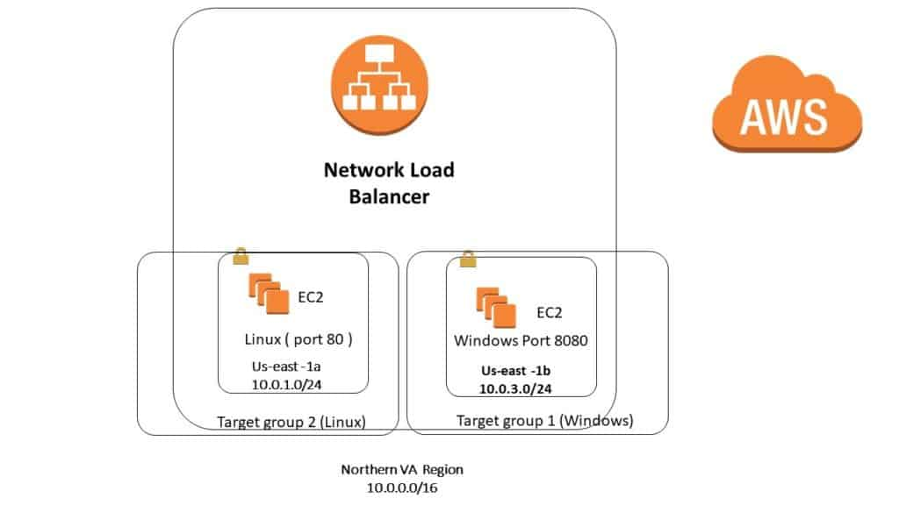
Network Load Balancer

Slide 9

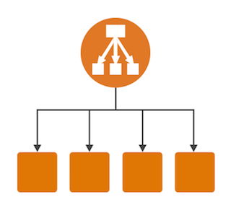
Classic Load Balancer
Classic Load Balancer provides basic load balancing across multiple Amazon EC2 instances and operates at both the request level and connection level.
Classic Load Balancer is intended for applications that are built within the EC2-Classic network.
You can load balance HTTP/HTTPS applications and use Layer 7-specific features, such as X-Forwarded and sticky sessions.
You can also use strict Layer 4 load balancing for applications that rely purely on the TCP protocol
Example: General purpose Car/Laptop

Slide 10



Error in Load balancing
If your application stops responding the elastic load balance or Classic load balancer responds with a 504 error.
This means that the application is having issues. This could either be at the web server layer or the database layer.
It's not the load balancer itself that's having the issue. It's something below the load balance.
Identify where the application is failing and scale it up or out where possible

Slide 11


X-Forwarded-For Header
10.0.2.15
10.0.2.15
192.162.162.1
Header : {X-forwarded-For : 192.162.162.1}

Slide 12
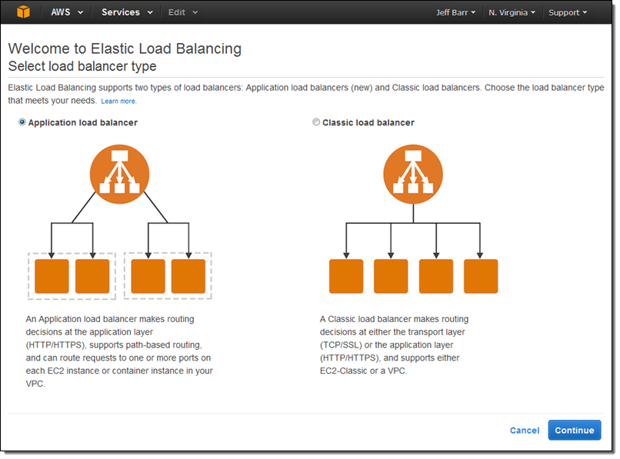
Classic Load Balancer

Slide 13
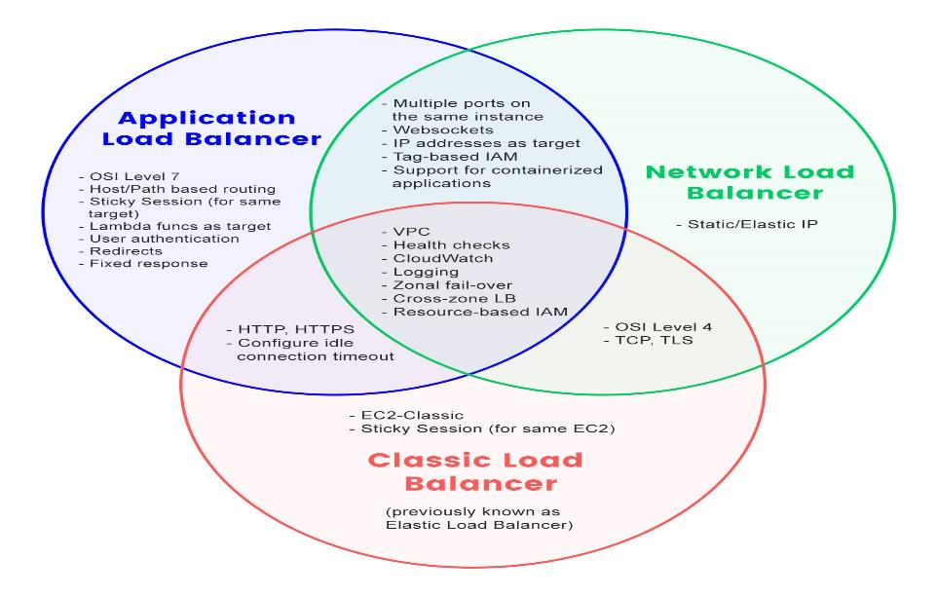

Slide 14
Exam Tips:
3 Types of Load Balancers:
Application Load Balancers
Network Load Balancers
Classic Load Balancers
504 Error Means the gateway has timed out :- This means that the application not responding within the idle timeout period. Trouble shoot the application. Issue might be at Web Server or Database Server.
If you need the IPv4 Address of your end user, look for the X-Forwarded-For header.

Slide 15
Thank you

